Slide 1
Visual Analytics: Structuring Space
Ian Nabney
ian.nabney@bristol.ac.uk

Slide 2
Overview
Reading: Chapter 3 of Ware
Understand how patterns are constructed and reconstructed from the real world
Able to apply this understanding to solve design problems

Slide 3
Pattern formation
Patterns are formed in a middle ground of fluid dynamic visual processing that both pulls meaningful patterns from features in V1 and imposes order
Understanding how patterns are constructed and reconstructed can tell us a lot about the design problems of organizing space, either in ways that are unambiguous and clear, or in ways that are subject to multiple interpretations
Two-dimensional patterns are fundamental for two reasons:
They are the precursors of objects
They can be a relationship between objects
In some ways, pattern finding is the very essence of visual thinking, and often to perceive a pattern is to solve a problem

Slide 4
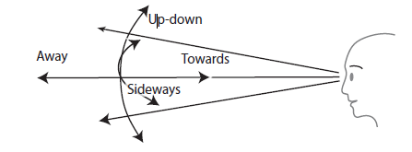
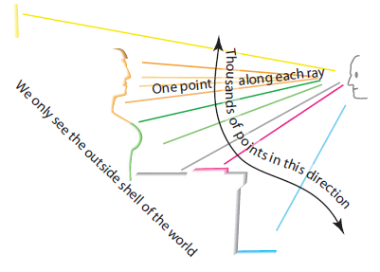
Space and depth perception
About a million fibres in each optic nerve transmit to the brain information about the world in the combined up-down and sideways dimensions
For each of those points of information there is, at best, one additional piece of distance information relating specifically to the away dimension, and this extra information must be indirectly inferred
Sometimes people say visual space has 2.5 dimensions
It would be more accurate to say that visual space has 2.05 dimensions
Image plane refers to up-down and sideways dimensions combined
Depth is used to refer to away information

Slide 5
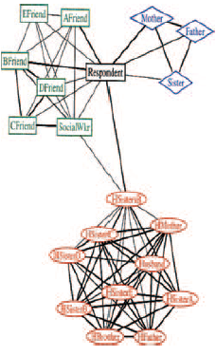
Tasks as pattern finding
The task of finding a route from one city to another is a problem of pattern finding
When an anthropologist draws a diagram of the relationships of all of the people in a remote village, the patterns help them understand the social structure.

Slide 6
Binding: features to contours
The process of combining different features that will come to be identified as parts of the same contour or region is called binding
There is no such thing as an object embedded in an image; there are just patterns of light, shade, colour, and motion
Objects and patterns must be discovered, and binding is essential because it is what makes disconnected pieces of information into connected pieces of information
Incoming information first arrives in visual area V1 at the back of the brain. The information then passes successively through V2 and V4 and then to the inferotemporal cortex (IT)
Signals from the prefrontal cortex are sent back to consolidate task-relevant patterns
This is the what pathway, as opposed to the where pathway

Slide 7
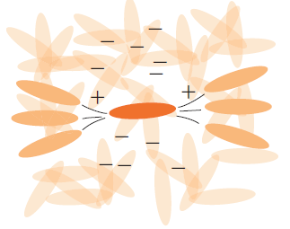
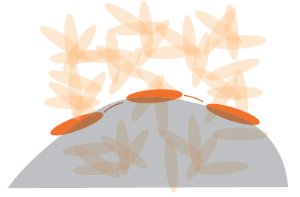
Binding: edge detection
Edge detector neurons have a positive excitatory relationship with other edge detectors that are nearby and aligned
There is an inhibitory relationship with cells responding to non-aligned features
When light from an edge falls across the receptive fields of positively connected neurons a whole chain of neurons will start pulsing together
They are bound together by this common activity
This is modified by our attention

Slide 8
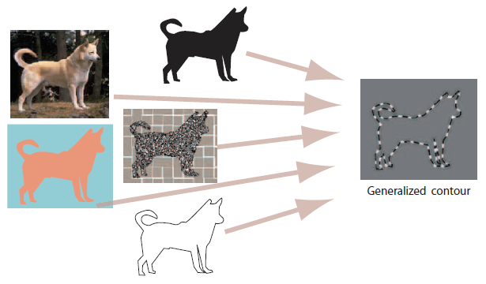
Generalised contour
An object may be separated from its background in many different ways including luminance changes at its silhouette, colour differences, texture boundaries, and even motion
Therefore the brain requires a generalized contour extraction mechanism in the pattern-processing stage of perception
In the lateral occipital cortex with input from V2 and V3
Many different kinds of boundary can activate a generalized contour
A generalized contour does not actually look like anything. It is a pattern of neural activation in part of the brain.

Slide 9
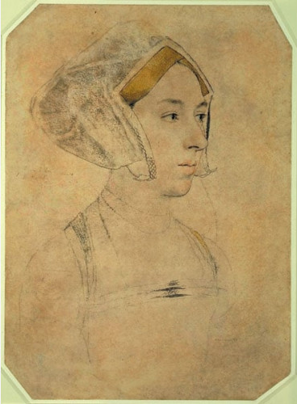
Why are line drawings so effective?
Why are line drawings are so effective in conveying different kinds of information?
A pencil line is nothing like the edge of a person’s face, yet a simple sketch can be instantly identifiable
The explanation of the power of lines is that they are effective in stimulating the generalized contour mechanism
Portrait of a Lady, sometimes identified as Anne Boleyn
Hans Holbein the Younger

Slide 10
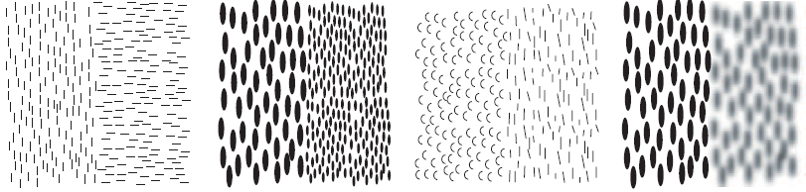
Texture regions
In general, the same properties that make individual symbols distinct (discussed in the week 3 lectorial) will also make textures distinct
Primarily these are element orientation, size contrast, and colour—the properties of V1 neurons in the primary visual cortex
Mutual excitation between similar features in V1 and V2 explains why we can easily see regions with similar low-level feature components through spreading activation
More complex texture patterns do not allow for the rapid segmentation of space into regions. Only basic texture differences should be used to divide space
Orientation Grain size Curve versus straight Blur

Slide 11
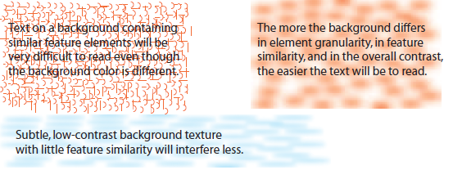
Interference and selective tuning
As a general rule, like interferes with like
To minimize this kind of visual interference maximize feature-level differences between patterns of information
Attentional tuning operates at the feature level, rather than the level of patterns
Nevertheless, because patterns are made up of features we can also choose to attend to particular patterns if the basic features in the patterns are different

Slide 12
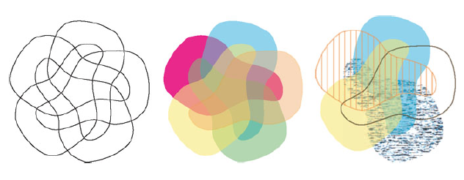
Patterns, channels and attention
(a) (b) (c)
If many overlapping regions are to be shown then a heterogeneous channel-based approach can help
(a) every combination of five overlapping regions is shown.
(b) using colour is clearer, but still confusing
(c) uses colour, texture, and outline. Take any point and it is easy to see the set of regions to which it belongs

Slide 13
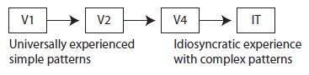
Pattern learning
There is a critical period in the first few years of life when the neural pattern-finding systems develop. The older we get, the worse we are at learning new patterns, and this seems to be especially true for the early stages of neural processing.
Someone who lives in New York will have more cells tuned to vertical and horizontal edges than who hunts in the tangle of a rainforest.
All visual thinking is skilled and depends on pattern learning.
As an individual becomes skilled, increasingly complex patterns become encoded for rapid processing at the higher levels of the what pathway.
For the beginning reader, a single fixation and a tenth of a second may be needed to process each letter shape.
The expert reader will be able to capture whole words as single perceptual chunks if they are common.
This gain in skill comes from developing connections in V4 neurons that transform the neurons into efficient processors of commonly seen patterns.

Slide 14


Spatial layout and patterns
Pattern perception is more than contours and regions. Groups of objects can form patterns based on the proximity of the elements.
Pattern detection mechanisms work on many scales; some neurons respond best to large shapes, others respond to smaller versions of those same shapes
V4 neurons still respond strongly to patterns despite distortions that stretch or rotate the pattern, so long as the distortion is not too extreme
This is a critical property that allows us to recognize shapes and patterns
A single V4 neuron might respond well to all of these different T patterns

Slide 15



Horizontal and vertical
The up-down and the sideways directions are special.
We are very sensitive to whether something is exactly vertical or horizontal and can make this judgment far more accurately than judging if a line is oriented at forty-five degrees. Two reasons:
maintaining our posture with respect to gravity;
our modern world contains many vertically oriented rectangles and so more of our pattern-sensitive neurons become tuned to vertical and horizontal contours
We can use this in design choices
The line on the right is only rotated 3 degrees from the vertical, yet this
departure from vertical is clearly evident
We are extremely sensitive when judging small end-to-end misalignments of straight lines

Slide 16
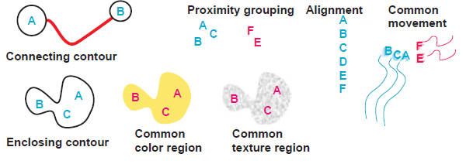
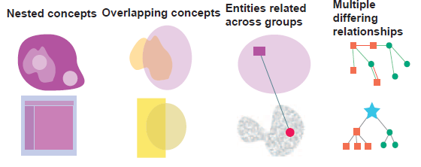
Pattern for relationships

Slide 17
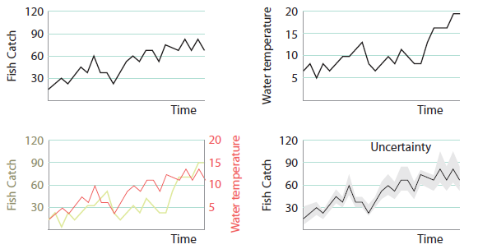
Pattern queries
Line Graph: Supports reasoning about how one measured variable changes with another
Determine fish catch as it varies over time. Common tasks are to determine when the maximum and minimum catches occurred, and whether the catch is trending up or down.
Often people reason by comparing one graph against another. Is the fish catch is correlated with water temperature? Design note: Visual queries to find corresponding patterns are much easier to make if the two graphs can be combined.
A degree of uncertainty in measurements can be represented by a broad swathe showing the uncertainty range at each point.

Slide 18
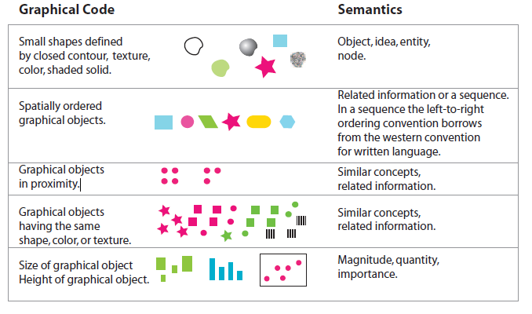
Semantic pattern mappings

Slide 19
Conclusions
Leaving aside people with special visual problems, and concentrating on urban dwellers, at the level of V1 everyone is pretty much the same, and this means that design rules based on V1 properties will be universal
Spatial analogies are fundamental to human reasoning, which is ultimately grounded in human experience gained by interacting with the environment
The sequence of processing from V1 through the inferotemporal cortex can be thought of as a series of ever more complex pattern processors, with the patterns at each level being made up of the simpler patterns processed by the preceding levels
Thus complex patterns are patterns of patterns

